Slide 1
Car accident death rates of 2021
By:
Adalbert payan, Frank Polus, evan burgett, and Jonathan yanes
Last updated: 08/03/2023
Notes:
Before clicking to show title:
We are presenting a topic that affects millions of lives and shapes our approach to road safety:
Click to show title:
Car fatalities in the US.
Yes, it’s not as upbeat as yesterday’s PowerPoints haha

Slide 2
Objective
  The objective of this presentation is to conduct an analysis of death rates caused by car accidents across different states while considering the total population of each state in the year of 2021. Our aim is to discern patterns, and correlations enabling us to present evidence-based insights that can inform decision-makers and stakeholders in public health and policy realms.

Slide 3
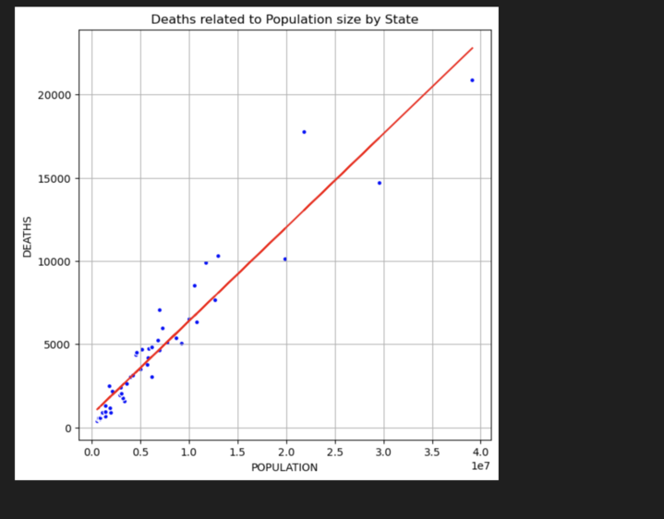
Population and accident correlation
Is population size directly related to accident deaths per year per state?
We were initially under the assumption that this would be correct.

Slide 4
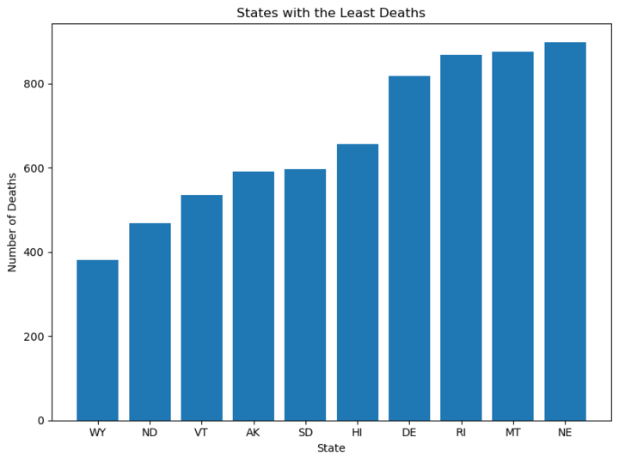
Least deaths analysis
STATE | DEATHS | POPULATION
WY | 381 | 579483
ND | 469 | 777934
VT | 536 | 646972
AK | 591 | 734182
SD | 596 | 896164
HI | 656 | 1447154
DE | 817 | 1004807
RI | 869 | 1096985
MT | 875 | 1106227
NE | 897 | 1963554

Slide 5
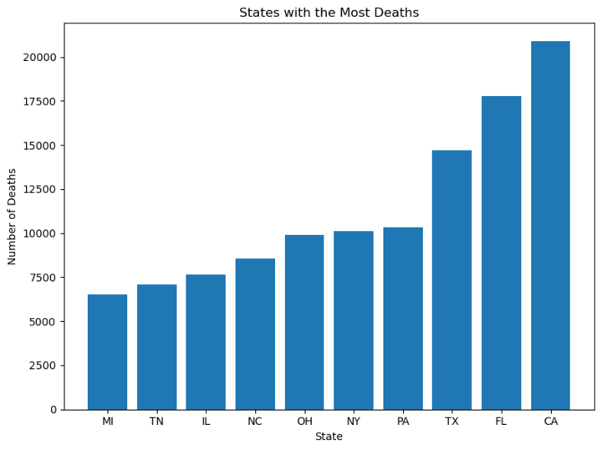
Most deaths analysis
STATE | DEATHS | POPULATION
CA | 20879 | 39142991
FL | 17780 | 21828069
TX | 14704 | 29558864
PA | 10327 | 13012059
NY | 10140 | 19857492
OH | 9919 | 11764342
NC | 8539 | 10565885
IL | 7664 | 12686469
TN | 7076 | 6968351
MI | 6541 | 10037504

Slide 6
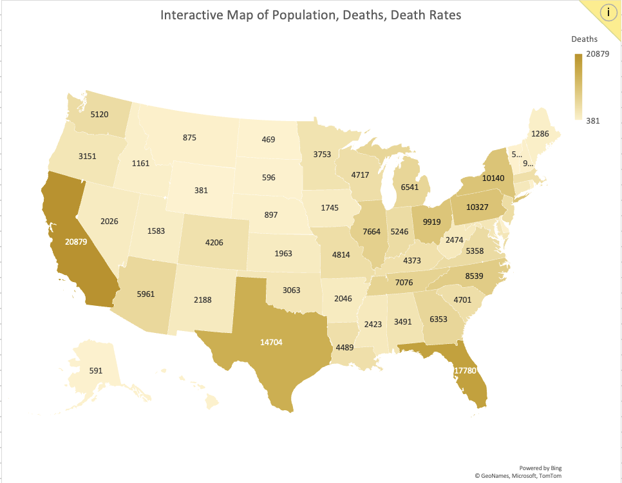
Geographical perspective
Deaths per state:
  Top 3 states: CA, TX, and FL
Interactive map time!
Notes:
Change over to Evan to do a more insight of death analysis

Slide 7
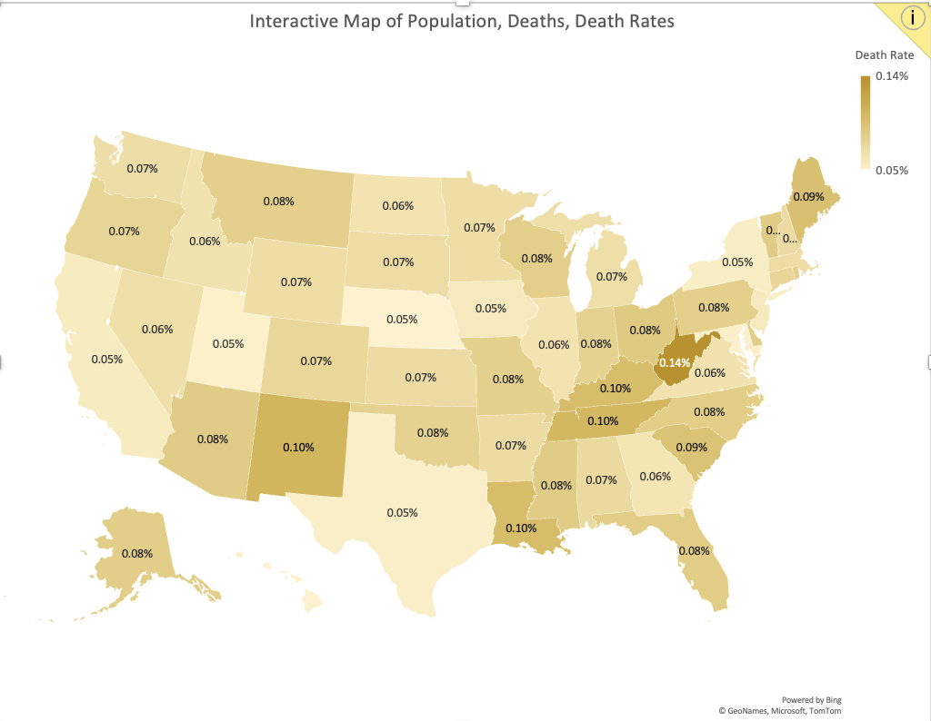

Slide 8
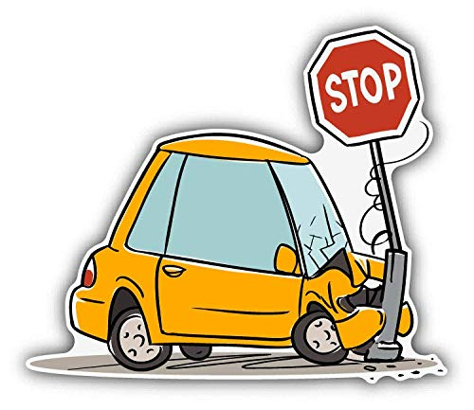
Unmeasured factors
Infrastructure and Traffic
Behavioral Factors
Emergency Response and Healthcare
Limitations
Notes:
First point:
Populated states have more transportation infrastructure and urban centers, leading to higher traffic and increased accident risks, resulting in more fatalities. Additionally, they may have more highways and major roads, prone to severe accidents.
Second:
In places with larger populations, there's more diversity in driving habits and road safety awareness. This can result in more risky driving, pedestrian negligence, and traffic rule violations, leading to more accidents and fatalities.
Third:
States with larger populations usually have better emergency response services and healthcare facilities. This can save lives after accidents but may also lead to more reported fatalities. Improved medical services increase the chances of quick medical attention, but they may not reduce the number of accidents overall
Fourth:
The conclusion is based on a specific dataset that might miss other factors affecting accident fatalities, such as road conditions, weather, law enforcement, and driver demographics.

Slide 9
Conclusion
In conclusion, states with higher populations have more accident deaths per year.
However, the data analysis shows that death rates do not directly correlate with population size.
Other unforeseen variables beyond the scope of this data set may be responsible for the increased death rates.

Slide 10
Questions?

